Slide 1
Impositioning
PrintNet T

Slide 2
Context Schema
Workflow
Data Input
&
Manipulation
Document
Design
(Layout)
Impositioning
Approval (Proof)
Spool Production

Slide 3
Agenda
Impositioning
Simple N-Upper

Slide 4

Impositioning – Introduction
Impositioning modules can:
  Transform pages (rotating, scaling, moving)
  Create booklets
  Add cut or fold marks
  Mix pages
  Re-order pages
  And perform other pre-printing functions
Impositioning does not affect the page Layout in any way.
Notes:
Impositioning does not affect the page Layout in any way. Impositioning modules only occur after the Layout modules in the workflow.

Slide 5

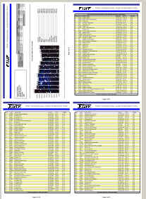
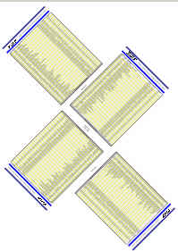
Impositioning – Purpose
Impositioning defines how a job will be printed on the printing sheet(s).
E.g:
  Several pages can be printed on one physical sheet (N-Up).
  Pages can be positioned differently on a sheet, and cut out later; cut marks would be needed.
  Page order on printers can be changed.
  Pages can be grouped based on variables.
Simple N-Upper module
Imposition Script module

Slide 6

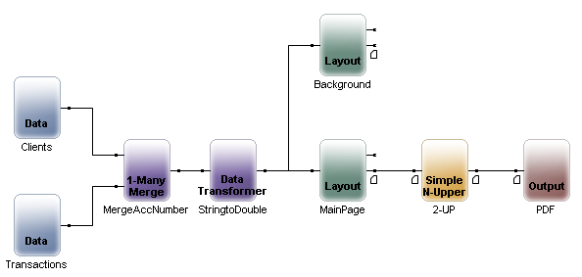
Impositioning in Workflow
Data input
Data Processing
Page design
Impositioning
Output
Notes:
Impositioning occurs after Layout in the workflow. Any changes to the job made in Impositioning modules WILL NOT affect the Layout design in any way; the only thing that will be affected is the way the designed pages are printed.

Slide 7

Impositioning – Tip
Grouping is Record-based by default. This can be changed using group-oriented impositioning modules.
SheetName variables must be set in Layout.
Notes:
Grouping is Record-based by default. To change grouping we use group-oriented impositioning modules. Groups can be used in production to split output, etc.
SheetName variables must be set in Layout if you want to add logic based on variables.

Slide 8

Impositioning and Output Module
Impositioning module:
  Define how many sheets will be “up” on the press.
Output module:
  Set the page size for the job.

Slide 9
Pivot Point
Impositioning modules set the point in the top, left corner of the page.
Any settings entered in any impositioning module will be measured from this pivot point in the top left corner of the page (0,0).

Slide 10
Common Impositioning Modules
Module | Short Description
Transformer | You can set parameters to: rotate pages; change their scaling and set horizontal and vertical offsets.
Simple N-Upper | Sets up the document for printing multiple pages per sheet with definable offsets and counts in either direction.
Sheet NS-Splitter | North/South split positioning of the pages within the sheets. You can set count and offset in both axes. See Sheet NS Splitter description.
Sheet Regrouper | Regroups sheets, based on given criteria such as group name change or group count.

Slide 11





Modules Description I
Sets up the document for printing multiple pages per sheet.
Produces brochures, books, etc.
Modifies output.
Concatenates the output of the layouts.
Upper Layout is printed on front page and second Layout is printed on back page.
Notes:
Sets up the document for printing multiple pages per sheet with definable offsets and counts in either direction.
Produces brochures, books, etc. You use this module to position, scale, and rotate pages within the output sheet(s) for a different range of input pages.
Modifies output. You can set parameters to: rotate pages; change the scaling of either axis (independently); and set both horizontal and vertical offsets.
Concatenates the output of the layouts. All the pages of the first layout are printed first, then pages from the second layout are appended. This module is not configurable.
Upper Layout is printed on front Page and second is printed on back page. Repeating is configurable.

Slide 12





Modules Description II
Enables users to pass sheets through that meet a specified group size or name criteria.
Places the content of two designed layouts together into a single layout.
North/South split positioning of the pages within the sheets. You can set count and offset in both axes.
Regroups sheets, based on given criteria – Sheet or Group count or SheetName change/condition.
Based on associated SheetName. Pages in the group are duplicated as many times as the value of SheetName variable on the first page of the group.
Notes:
The Sheet Filter module enables you to pass on to the output (or keep from passing to the output) only those sheets that meet specified group size or name criteria.
The Sheet Mixer places the content of two designed layouts together into a single layout. The content from one layout design is placed over the other. The two independent layouts may even have separate data input files. There are no options associated with this module.
North/South split positioning of the pages within the sheets. You can set count and offset in both axes.
Regroups sheets, based on given criteria – Sheet or Group count or SheetName change/condition.
Based on associated SheetName. Pages in the group are duplicated as many times as the value of SheetName variable on the first page of the group.

Slide 13





Modules Description III
Sheet Backgrounder merges two layouts.
Sheet Padder is used to fill pages to specified PageCount.
Marks Inserter enables you to insert targets and/or squares of the size and in the position you specify.
Sheet Sorter sorts sheets by SheetName variable from each sheet within one group; or it sorts groups by the first Sheet SheetName variable in every group.
Sheet Inserter inserts all sheets from the layout connected to second input.
Notes:
The Sheet Backgrounder module merges two layouts. The layout connected to the top connector presents the background and is printed first. The layout connected to the bottom connector is printed over the background.
The Sheet Padder is used to fill pages to specified PageCount. Ex. when you duplex a job and wish to ensure that the last page of a document ends on an even numbered page.
The Marks Inserter module enables you to insert targets and/or squares of the size and in the position you specify.
Sheet sorter can be used in two ways:
It sorts sheets by SheetName variable from each sheet within one group .
It sorts groups by the first Sheet SheetName variable in every group.
The Sheet Inserter module inserts all sheets from the layout connected to second input before or after every n sheet; or before or after every n group (records).

Slide 14





Modules Description IV
The Region Binder module enables the sorting of envelopes according to their zip code and weight.
The purpose of this module is to filter the incoming sheets according to their pattern sequence.
Fully programmable positioning module. You can define multiple input and output nodes.
Allows sheets for printing to be chosen by variable from a separate data input. Saves modules in postprocessing; fewer Outputs needed.
Decides which handling groups to be printed.
Notes:
The Region Binder module enables the sorting of envelopes according to their zip code and weight. It is customer specific and needs special configuration before use.
The purpose of the MediaPatterFilter module is to filter the incoming sheets according to their pattern sequence. Whatever passes through the sequence goes to first output, all others to second one.
Fully programmable positioning module. You can define multiple input and output nodes, work with groups, SheetNames, and page layers.
Sheet Multiplexer allows sheets for printing to be chosen by variable from a separate data input. Saves modules in postprocessing; fewer Outputs needed.
Decides which handling groups to be printed.

Slide 15

Impositioning – Simple N-Upper
Sets up the document for printing multiple pages per sheet with definable offsets and counts in either direction.
Impositioning modules are placed between Layout and Output modules
Output module is necessary
Notes:
If impositioning modules are used in the workflow, then they must be connected to Output modules in order to run Proof and Production. No printing will be possible without an Output module.

Slide 16
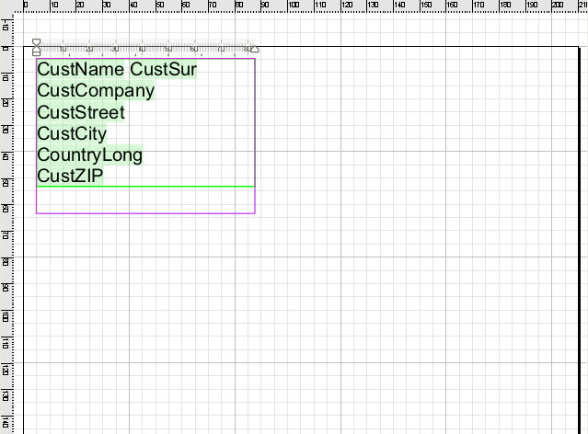
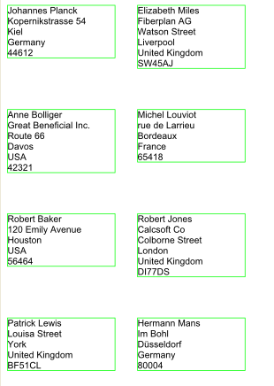
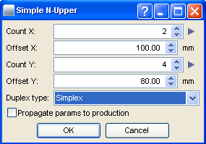
Simple N-Upper – Example
100.00mm
80.00mm
Layout
Impositioning
Proof
Notes:
This slide has animation: go through the points piece by piece.

Slide 17
Impositioning – Page Size
When performing any Impositioning, be aware of your page sizes in Layout.
Your offsets and other transformations will need to correspond to the page size.

Slide 18
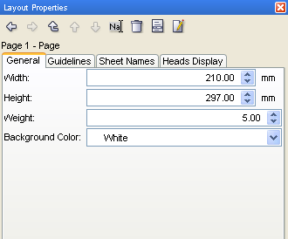
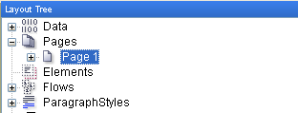
Changing Page Size in Layout
In Layout, click on an individual page node and change the size in Layout Properties.
Be aware of your page size settings in Layout when using Impositioning modules.
Notes:
Width 210; Height 297 – Standard A4 sheet size in Portrait
Width 297; Height 210 – Standard A4 sheet size in Landscape
For more about ISO standard paper sizes, see: http://en.wikipedia.org/wiki/Paper_size

Slide 19

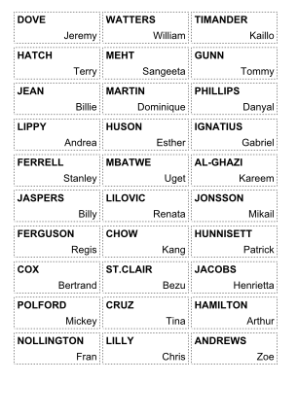
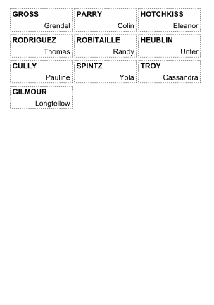
Impositioning – Exercise
Create a set of filing cabinet name tags for a company.
  Create a new workflow
  Use Nametages.csv as Data Input; insert the appropriate modules, and design a Layout using only ONE flow area, so that you have a proof that looks like this:
Page 1
Page 2
Notes:
Check Nametags_done.wfd for the finished resolution.

Slide 20

Impositioning – Summary
In this presentation we have learned:
  That Impositioning modules come after Layout, and do not affect a job’s design in any way.
  That Impositioning modules are used for positioning pages on a print sheet.
  How to use the X-Count, Y-Count, X-Offset, and Y-Offset in the Simple N-Upper module.
  How to change page size in Layout.

Slide 21

Impositioning – Discussion
What is the pivot point for all Impositioning modules?
How can Impositioning modules be used to change a Layout design?
If you want to proof or print a workflow that uses an Impositioning module, what else is necessary?
Why is the page size in Layout important when considering Impositioning modules?
Notes:
1. What is the pivot point for all Impositioning modules?
The upper left-hand corner of the page (0,0).
How can Impositioning modules be used to change a Layout design?
They can’t.
If you want to proof or print a workflow that uses an Impositioning module, what else is necessary?
An Output module.
Why is the page size in Layout important when considering Impositioning modules?
Because when you use Impositioning modules, you’re dealing with the transformation and/or positioning of the Layout page itself upon a printing sheet. Page size is important so that you know how far pages needs to be to distanced from each other, and how much space there is to work with on the printing sheet itself.

Slide 22

Thank You.
Do You Have Any Questions?

